Slide 1
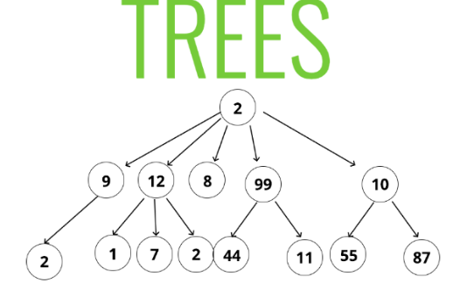
5.Tree and Graph
A tree is a non-linear data structure.
Trees are mainly used to represent data containing a hierarchical relationship between the elements.
A tree is defined as a finite set of one or more nodes.

Slide 2
There is a node designated as the root of the tree and other nodes are the children of the root node.

Slide 3
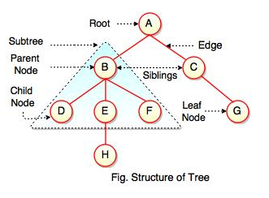
The above figure represents structure of a tree. Tree has 2 subtrees. A is a parent of B and C. B is called a child of A and also parent of D, E, F.

Slide 4
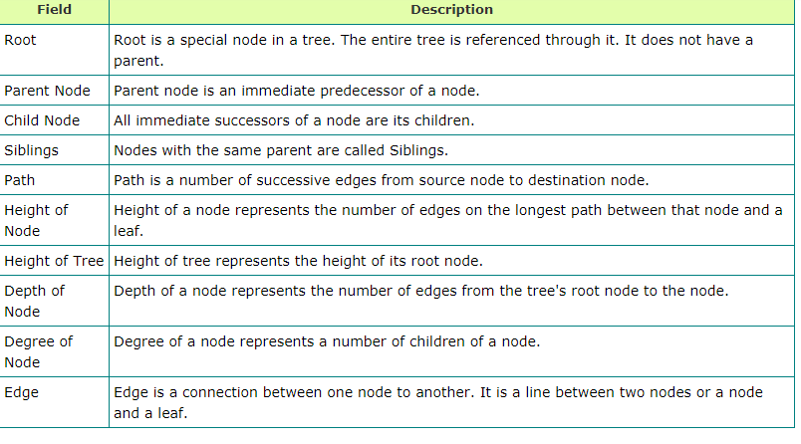

Slide 5
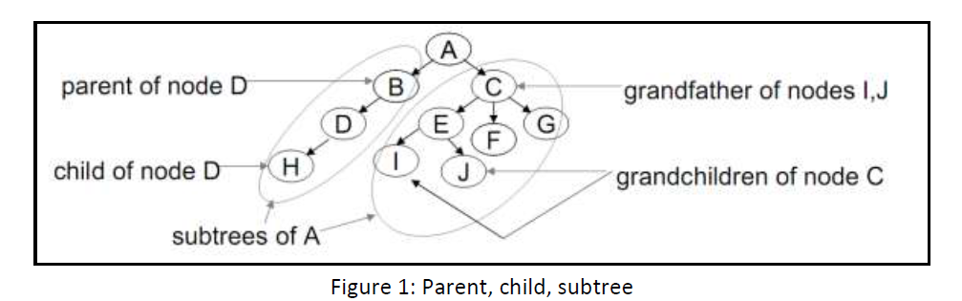

Slide 6
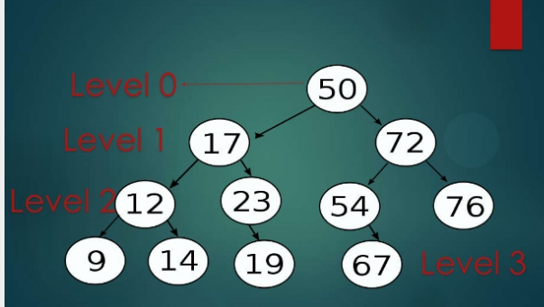

Slide 7
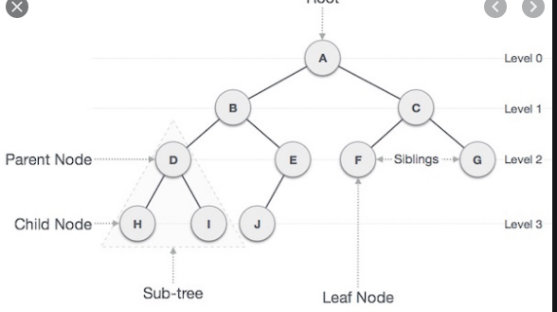

Slide 8
i. Parent: The predecessor of a node.
ii. Child: Any successor of a node.
iii. Siblings: Any pair of nodes that have the same parent.

Slide 9
Tree :- A tree is defined as a finite set of one or more nodes.
The top most node in the tree is the root node.
A
A is the root node
B
C
F
G
D
E
I
H

Slide 10
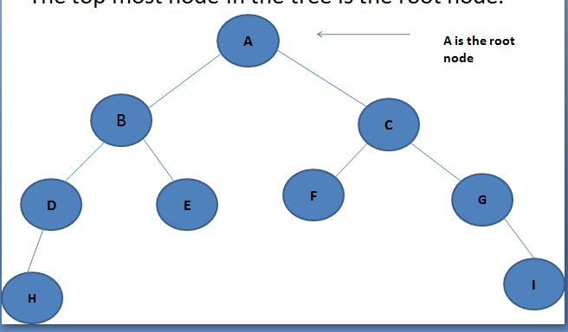
Degree of a node:- Degree of a node is equal to the number of children that a node has.
Node B has 2 children's ,so degree of node B is 2.

Slide 11
Degree of the tree:-The maximum degree of the nodes in the tree is known as the Degree of the tree.
For this tree ,the degree of the tree is 3.

Slide 12
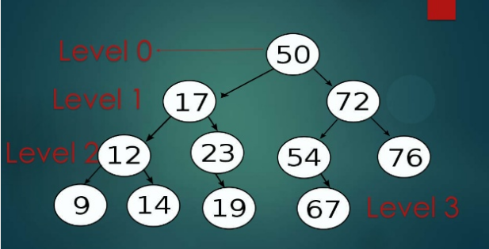
Level of a Node:-Level is a rank of the hierarchy. Every node in the tree is assigned a level number. The root is defined at level 0.

Slide 13
Leaf Node:- A node that has no children is called the leaf node or terminal node.
In fig. Nodes H,E,F,I are the leaf nodes.

Slide 14
Depth/Height of a Tree:- The length of the path from the root node to the deepest node in the tree is known as Height of the tree.
Below tree have a depth/height is 4.

Slide 15
Indegree of a Node:- The number of edges arriving at that node is known as Indegree of a node.
In fig :-Indegree of node B is one.

Slide 16
Outdegree of a Node:- The number of edges leaving that node is known as Outdegree of a node.
In fig:- Outdegree of a node B is 2

Slide 17
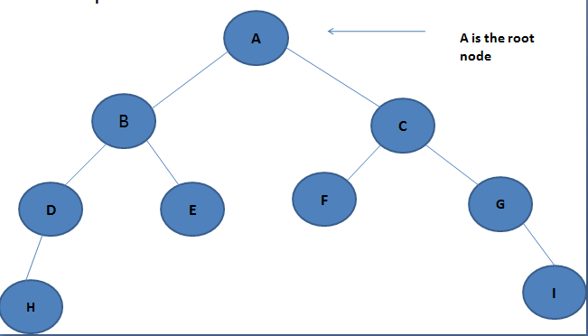
Directed Edge:-The line drawn from a node N to any of its successor is known as Directed Edge.
In fig. The line drawn from C to F node

Slide 18
Path:- A sequence of consecutive edges is called path
In fig:- A,C,G,I can be a path
Or A,B,D,H can be a path

Slide 19
Ancestor Node:-The parent, grandparent ,the great grandparent of a node are called its Ancestors.
In fig. node A is the Ancestor node

Slide 20
Descendant Node:- The child,grandchild,or any child node down the hierarchy of a node is called its Descendant node.
In fig. the node H is the Descendant node.

Slide 21
Forest: Forest is a set of several trees that are not linked to each other.

Slide 22
Siblings:- Children of the same parent node are called Sibling Node.
In fig. node D,E,F,G are the sibling nodes.

Slide 23
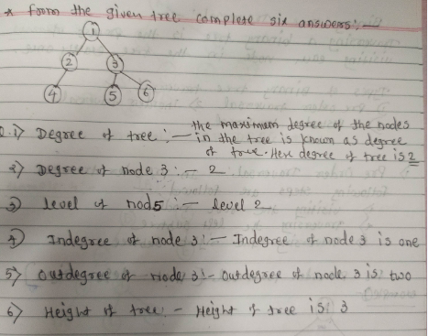

Slide 24
Types of Trees
1.General Tree
2.Binary Tree
3.Binary Search Tree
4.Expression tree

Slide 25
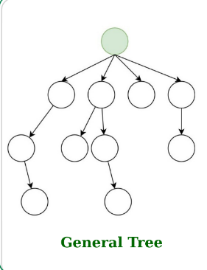
1.General Tree:- It is defined as a nonempty finite set of T elements, called nodes such that
The tree contains the root element.
The remaining elements of the tree form an ordered collection of zero or more disjoint trees T1,T2…..Tm.
Where T1,T2,…….Tm are sub trees of root and roots of T1,T2 …Tm are called successors of root node.

Slide 26
Difference between general tree and binary tree
GENERAL TREE | BINARY TREE
General tree is a tree in which each node can have many children or nodes. | Whereas in binary tree, each node can have at most two nodes.
The subtree of a general tree do not hold the ordered property. | While the subtree of binary tree hold the ordered property.
In data structure, a general tree can not be empty. | While it can be empty.
In general tree, a node can have at most n(number of child nodes) nodes. | While in binary tree, a node can have at most 2(number of child nodes) nodes.
In general tree, there is no limitation on the degree of a node. | While in binary tree, there is limitation on the degree of a node because the nodes in a binary tree can’t have more than two child node.
In general tree, there is either zero subtree or many subtree. | While in binary tree, there are mainly two subtree: Left-subtree and Right-subtree.

Slide 27
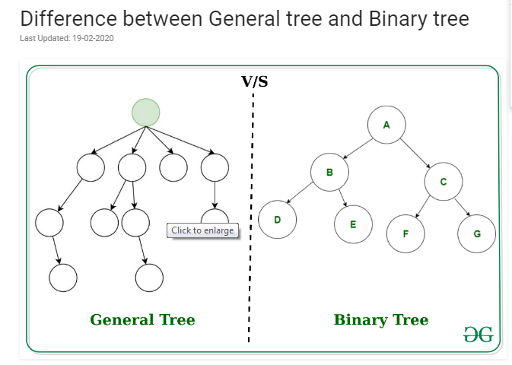

Slide 28
Binary Tree
Binary tree is a special type of tree in which every node has either no children, one children or at most two children's.

Slide 29
Binary Tree
Binary tree is a data structure in which a node can have at most two children.
Child of node in a binary tree on the left is called as “left child” and the node on the right is called as “right child”.

Slide 30
Operations on Binary tree
1.Creation:-Creating an empty binary tree to which root points.
2.Traversal:-To visit all the nodes in a binary tree
3.Deletion:- To delete a node from a non empty binary tree.

Slide 31
Operations on Binary tree
4.insertion:- To insert a node into an existing binary tree.
5.Merge:-To merge two binary trees.
6.Copy:- Copy a binary tree.
7.Compare:- Compare two binary trees.

Slide 32
Algorithm to create a binary tree
Step1: If value of new element is less than current element then go to step2 or else step3
Step2:- If the current element does not have a left subtree then make our new element the left child of the current eleement else make the existing left child as our current element and goto step1

Slide 33
Algorithm to create a binary tree
Step3:- if the current element does not have a right sub tree then make our new element the right child of the current element, else make the existing right child as our current element and go to step1

Slide 34
Binary Tree Traversal
Traversing a binary tree is the process of visiting each node in the tree exactly once.
Types of Binary Tree Traversal:-
1.Preorder traversal(root left right)
2.Inorder traversal (left root right)
3.Postorder traversal (left right root)

Slide 35
1.Preorder traversal(root-left-right)
In preorder traversal following steps are followed:-
1.Visiting the root node
2.Traversing the left sub tree
3.Traversing the right sub tree

Slide 36
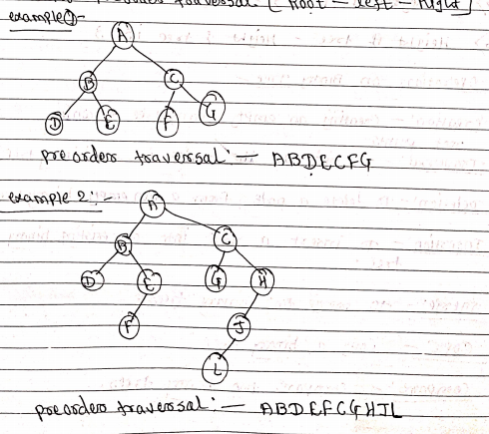
1.Preorder traversal(root-left-right)

Slide 37
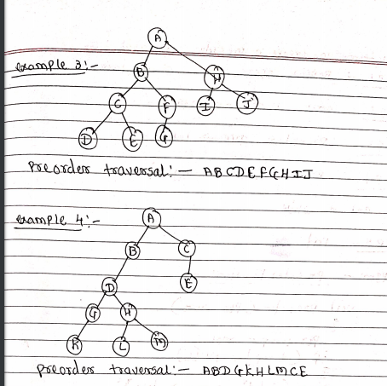
1.Preorder traversal(root-left-right)

Slide 38
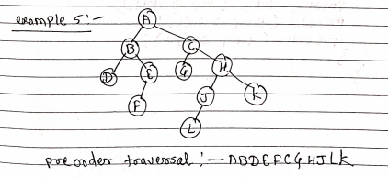
1.Preorder traversal(root-left-right)

Slide 39
Algorithm to create a preorder traversal
Step1: Repeat steps 2 to 4 while tree!=NULL
Step2: write (tree->data)
Step3:preorder(tree->left )
Step4:preorder(tree->right)
End of while
Step 5:end

Slide 40
2.Inorder traversal(left-root-right)
In Inorder traversal following steps are followed:-
1.Traversing the left subtree
2.visiting the root node
3.Traversing the right subtree

Slide 41
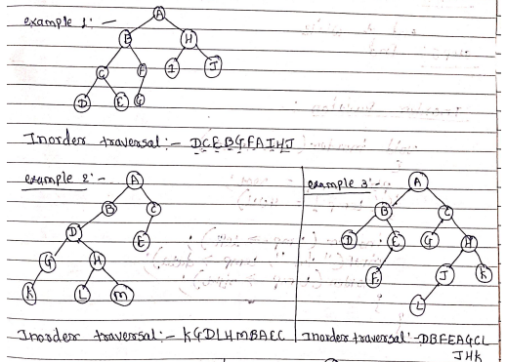
Inorder (left-root-right)

Slide 42
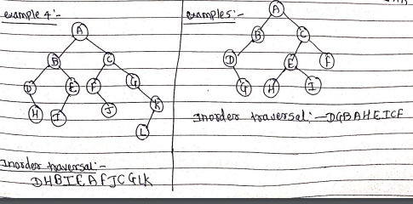
Inorder (left-root-right)

Slide 43
Algorithm to create a Inorder traversal
Step1: Repeat steps 2 to 4 while tree!=NULL
Step2:inorder(tree->left )
Step3: write (tree->data)
Step4:inorder(tree->right)
End of while
Step 5:end

Slide 44
3.Postorder traversal(left-right-root)
In Postorder traversal following steps are followed:-
1.Traversing the left sub tree
2.Traversing the right subtree
3.Visiting the root node

Slide 45
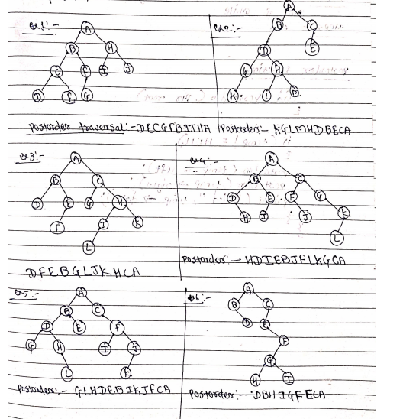
3.Postorder traversal(left-right-root)

Slide 46
Algorithm to create a Post order traversal
Step1: Repeat steps 2 to 4 while tree!=NULL
Step2:postorder(tree->left )
Step3: postorder (tree->right)
Step4:write(tree->data)
End of while
Step 5:end

Slide 47
Binary Search Tree(BST)
A binary tree is said to be binary search tree when all nodes less than the root node are placed at the left of root node and all nodes greater than the root node are placed at the right of root node.
38
14
56
8
23
45
82
18
70

Slide 48
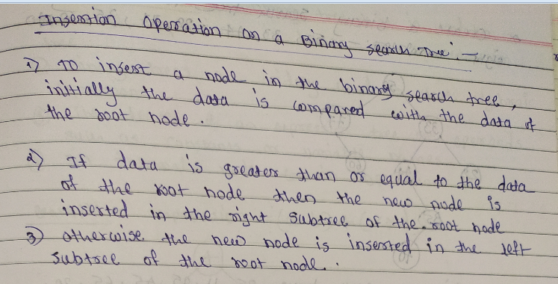

Slide 49
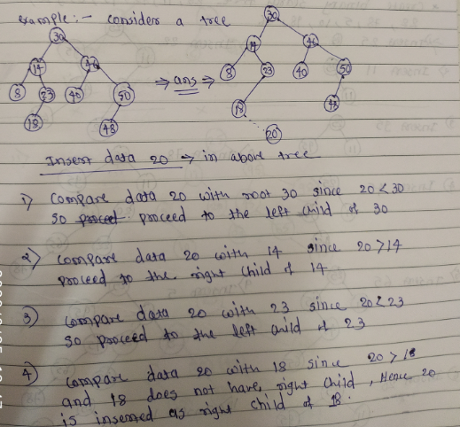

Slide 50
Expression Tree
A binary tree that is used to evaluate expressions is known as an expression tree.
Binary trees are used to store algebraic expressions.
The leaves of an expression tree are operands such as constants or variable names.
All internal node contain operations.

Slide 51
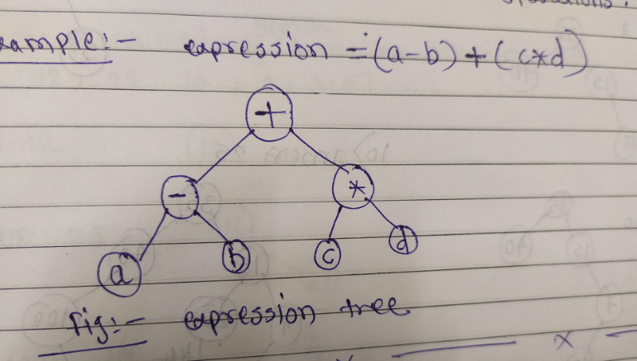

Slide 52
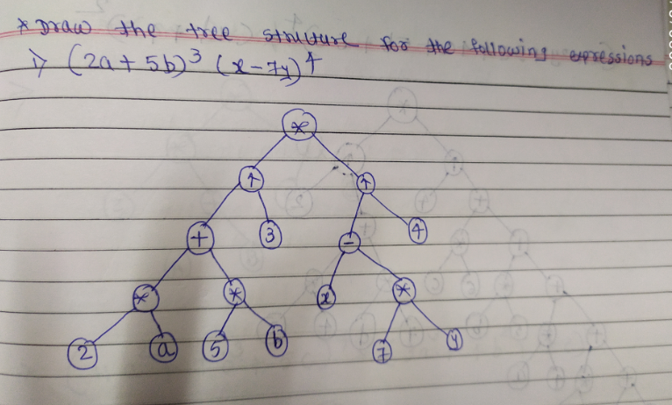

Slide 53
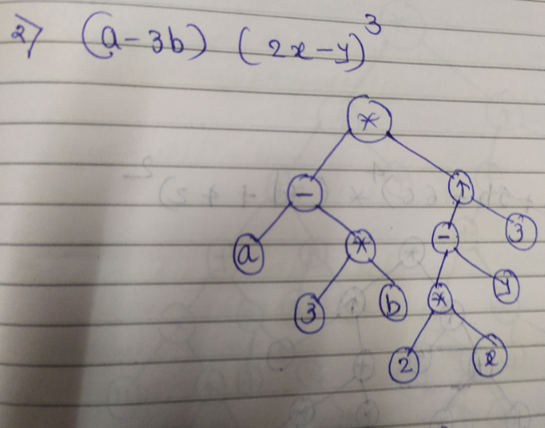

Slide 54
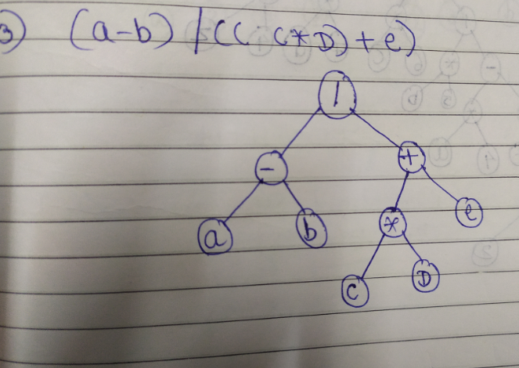

Slide 55
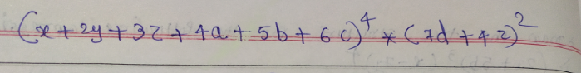
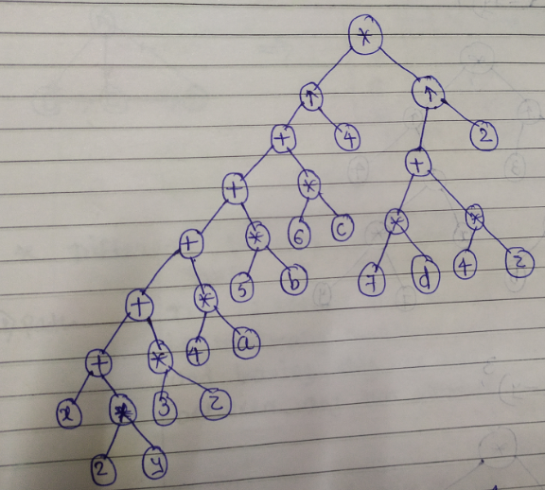

Slide 56
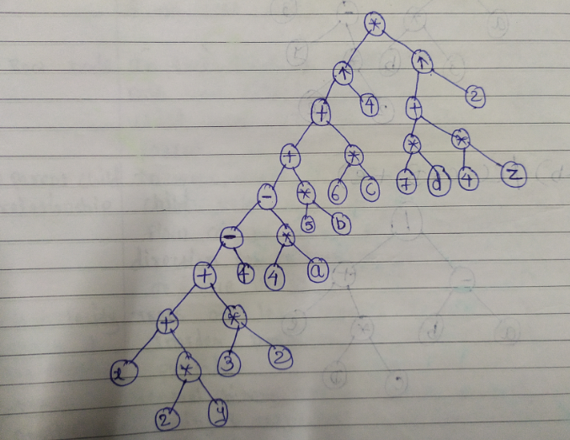

Slide 57
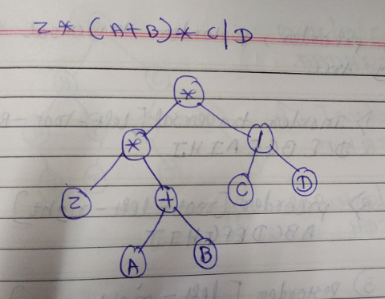

Slide 58
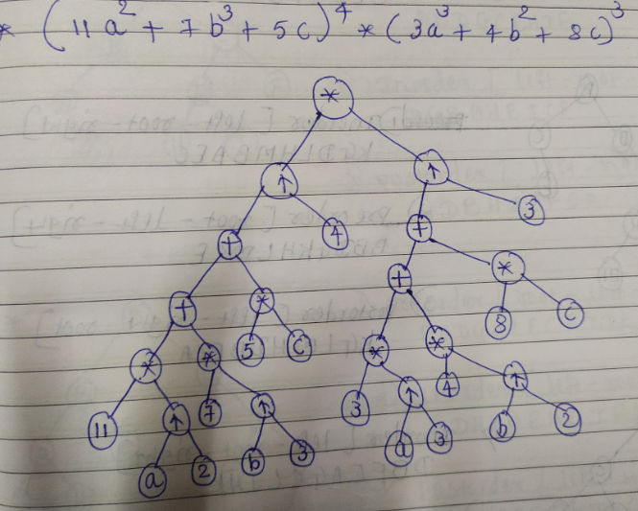

Slide 59
Applications of Binary tree
1.Trees are used to store simple as well as complex data.
2.Trees are used for compiler construction
3.Trees are used for implementing data structures like hash tables ,sets and maps.
4.Trees are used in database designs.

Slide 60
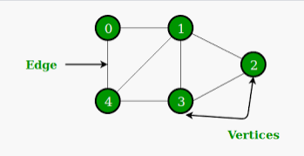
Graph
Graph is a non-linear data structure.
A graph is a collection of two sets V and E
Where V is set of vertices and E is set of edges.
A graph can be represented as the collection of two tuples i.e. G=(V,E)

Slide 61
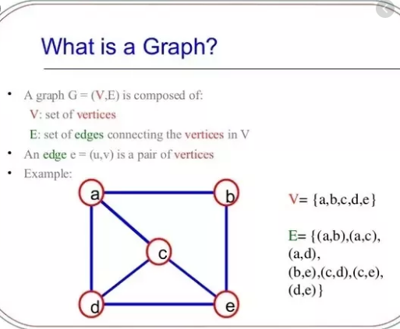

Slide 62
Fig. graph
The set of Vertices in above graph is {A,B,C,D,E}
The set of Edges are:- {(A,B),(A,D),(A,C),(C,D),(C,E)}
B
A
D
C
E

Slide 63
Concepts of Graph
Nodes(Vertex):-A graph G is defined as an ordered set (V,E) where V(G) represents the set of vertices or nodes.
V(G)= {A,B,C,D,E}
A
B
C
D
E

Slide 64
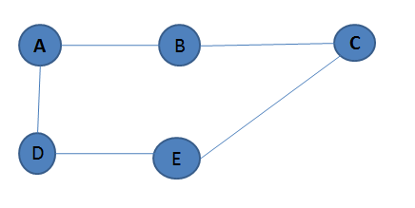
Edges :- An edge is drawn between one node to another node. In above fig. E(G)= {(A,B),(B,C),(A,D),(B,D),(D,E),(C,E)}

Slide 65
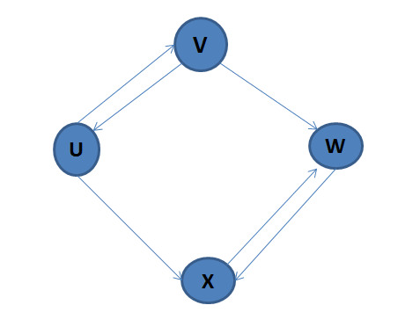
Degree of Node
Degree of vertex(node):- is the number of edges incident to it.
Degree of vertex u is 3

Slide 66
Indegree of Graph
V
U
W
X
The indegree of vertex is the number of edges that have V as the head.
The degree of Vertex u is 1.

Slide 67
Out degree
The outdegree of vertex is the number of edges that have V as the tail.
Outdegree of vertex u is 2

Slide 68
Adjacent
When there is an edge from one node to another node then this node is called as Adjacent node.

Slide 69
Successor
For an edge (U,V) the edge begins at u and terminates at V,so V is the successor of U

Slide 70
Predecessor
For an edge (U,V) the edge begins at U and terminates at V ,then U is the predecessor of V

Slide 71
Relation
The term relation is used in connection with sets.
R= {<1,2>,<1,3>,<2,4>,<4,4>}
2
1
4
3

Slide 72
Weight
A weighted graph is a graph in which edges are assigned weights i.e edges hold a value
A
5
2
B
C
3
Fig.Weighted Graph

Slide 73
Path
A path is a sequence of distinct vertices each ,adjacent to the next.
A
B
D
C
Fig.Path

Slide 74
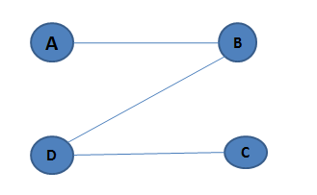
Length of Path
Length of path is nothing but total number of edges included in the path from source node to destination node.
Here the length of this graph is 3

Slide 75
Types of Graph
1.Directed Graph
2.Undirected Graph
3.Complete Graph
4.Connected Graph
5.Multigraph

Slide 76
Directed Graph
A directed graph G is also called digraph.
Each edge e in G is assigned a direction.
A
B
C
D

Slide 77
Undirected Graph
An undirected graph G is a graph in which each edge e is not assigned a direction.
A
B
C
D
Fig. Undirected Graph

Slide 78
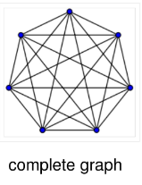
Complete Graph
A graph G is said to be complete graph if there exists an edge between every pair of vertices
A
B
C

Slide 79
Connected Graph
A graph G is said to be connected if there is at least one path between every pair of vertices in G.
A
D
F
B
C

Slide 80
Multi Graph
A graph which contain pair of nodes joined by more than one edge is called multigraph and such edges are called as parallel edges.
A
B
D
C

Slide 81
Representation of Graph
There are two methods of representing graph in computer memory.
1.Sequential representation of graph
2.Linked representation

Slide 82
1.Sequential representation of graph
The sequential representation of graph is done by means of adjacency matrix.
Adjacency matrix:- It is used to represent which nodes are adjacent to one another.
Or two nodes are said to be adjacent if there is an edge(line) connecting them.

Slide 83
Adjacency matrix A of Graph G is a two dimensional array of n*n elements where n is the number of vertices.
A[i][ j]=1 if there exist an edge between i and j
A[i][ j]= 0 if no edge exists between i and j

Slide 84
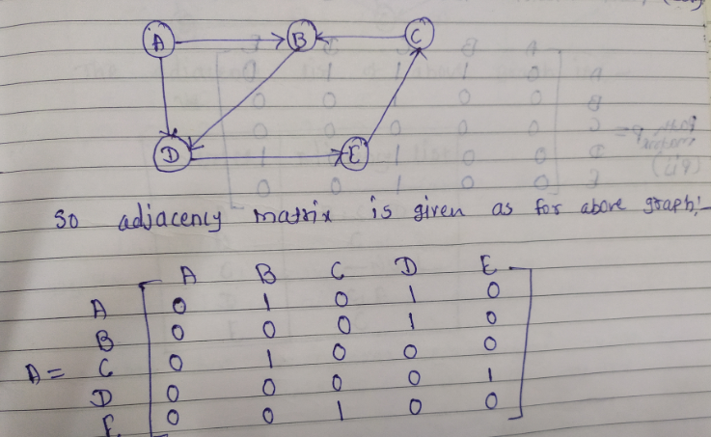
Adjacency Matrix for directed graph

Slide 85
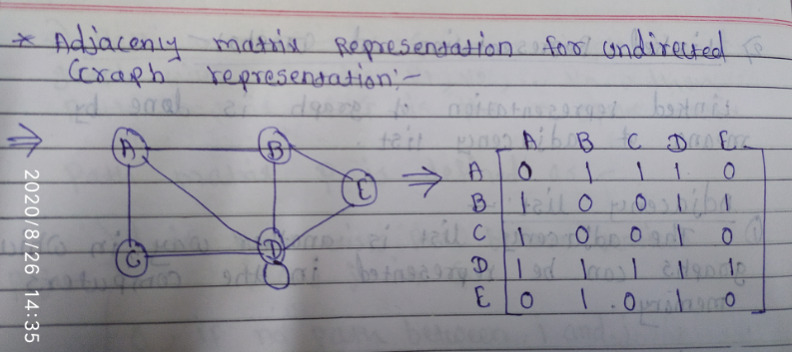

Slide 86
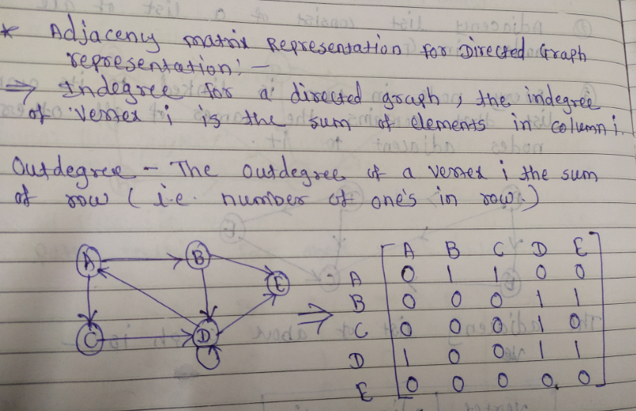

Slide 87
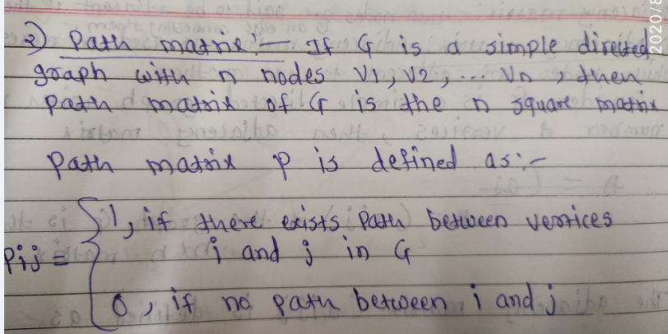

Slide 88
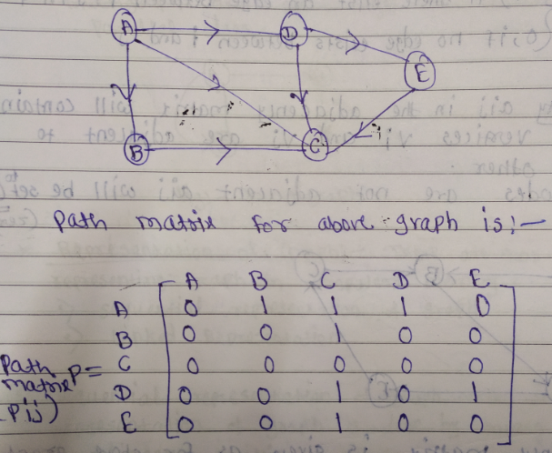

Slide 89
Adjacency matrix representation of Undirected Graph
Adjacency matrix representation of Directed Graph

Slide 90
2. Linked Representation of Graph
Linked representation of graph is done by means of adjacency list.
The Adjacency list is another way in which graphs can be represented in the computers memory.
Adjacency list consist of a list of all nodes in Graph
Every node is linked to its own list that contains the names of all other nodes adjacent to it.

Slide 91
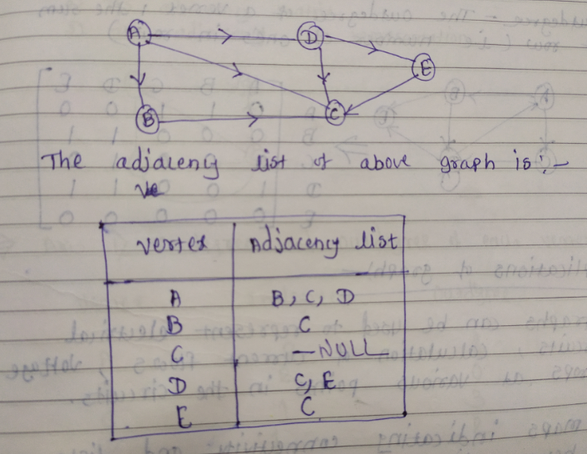

Slide 92
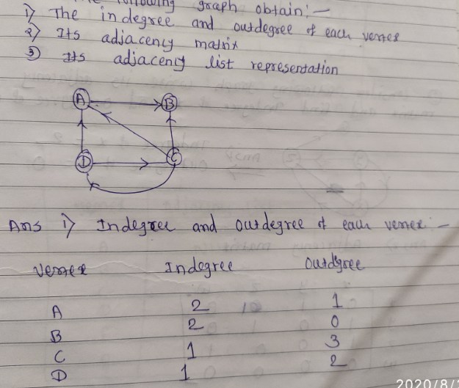
For the following graph obtain

Slide 93
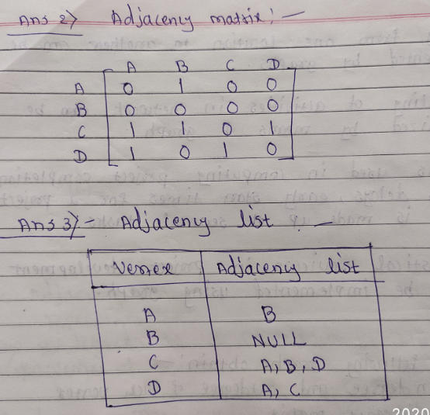

Slide 94
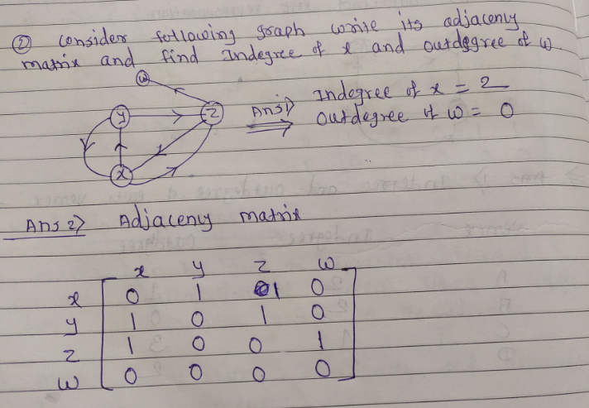

Slide 95
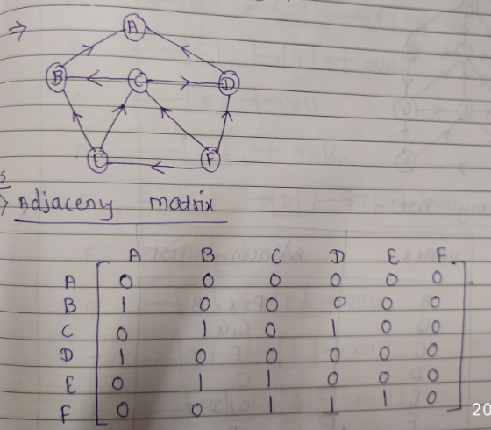
For following graph give its adjacency matrix and adjacency list

Slide 96
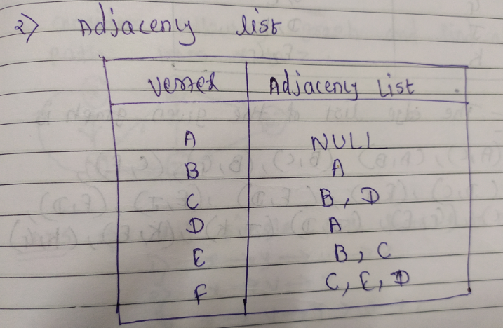

Slide 97
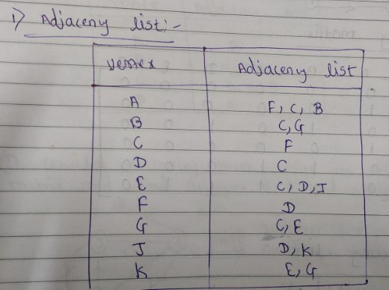
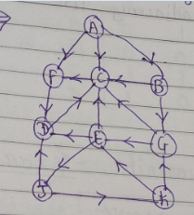
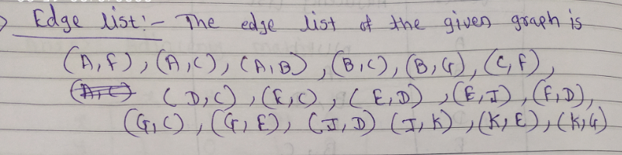
For following graph give adjacency list, edge list and storage representation for adjacency list

Slide 98
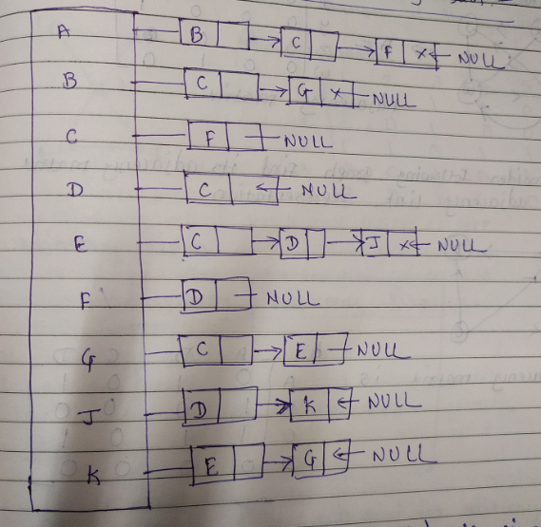
Storage representation

Slide 99


Slide 100


Slide 101


Slide 102



Slide 103



Slide 104


Slide 105


